Slide 1


With KNOX

Slide 2

SAMSUNG’S HUMBLE BEGINNING BACK IN 1938...

Slide 3

Galaxy Popularity Skyrocketing

Slide 4
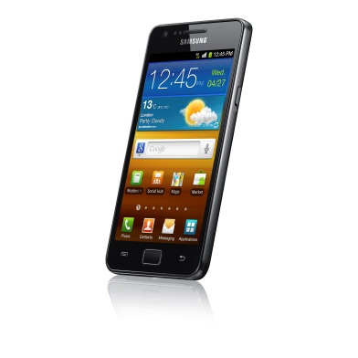
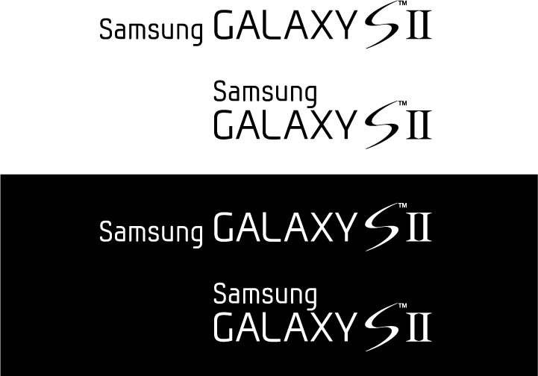
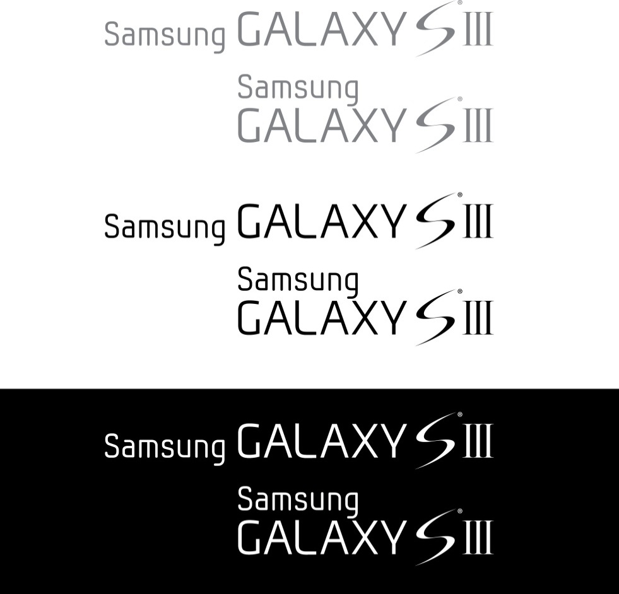

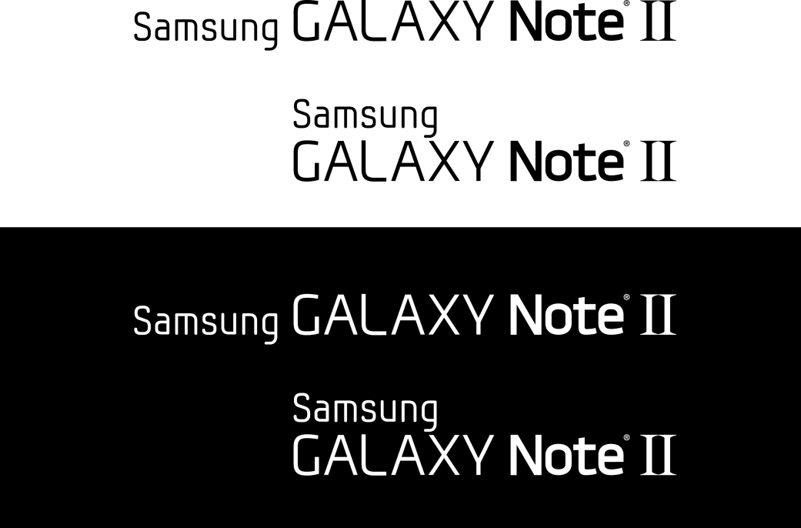
Latest Models Flying Off The Shelves
40 Million
20 Months
40 Million
7 Months
5 Million
2 Months
Notes:
The exponential increase in Galaxy series sales numbers show groundswell of demand for Samsung-branded Android devices.

Slide 5
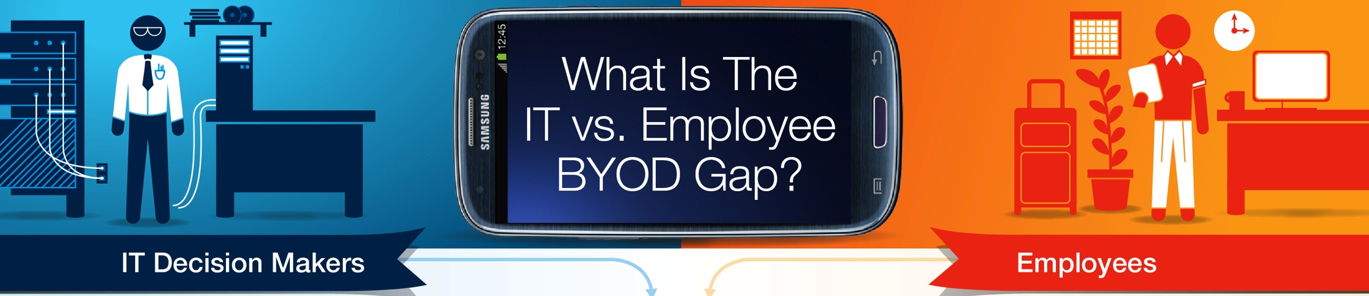

Meanwhile, BYOD and Android Have Taken Off
85% of Companies Support BYOD
BYOD
Android OS Comprises 75% of the Smartphone Market
*IDC & Strategy Analytics 2012
Notes:
Samsung’s market leadership, combined with the mainstream adoption of the Bring Your Own Device to Work trend, gives Samsung Mobile the competitive edge for gaining traction in the Enterprise this year.

Slide 6




How many Smartphones do you carry?
One for Work
One for Play
Secure Email & Web
Secure contacts & Calendar
Secure document sharing
Access company network via VPN
Manage devices
Remote wipe & Anti-theft . . .
Read personal Email
Surf the web & internet shopping
Watch Youtube video
Access Facebook and upload pictures
Listen to your favorite songs . . .

Slide 7



Samsung Pulls It All Together with SAFE
The Next Big Thing For Business Is Already Here ….
Samsung For Enterprise!
BYOD
Perception that Android devices aren’t secure
Lack of management controls for IT, made only worse by Android fragmentation …
Different versions
Different carriers
Different devices
Highly Desirable Devices
SAFE represents the ever-growing family of Samsung Enterprise solutions that include the necessary security and feature enhancements suitable for business use – on highly desirable devices recognized worldwide
BYOD
Android
Notes:
Samsung for Enterprise was engineered to specifically addresses security needs of enterprise IT departments that are increasingly beholden to scores of employees who are using their own mobile devices for work.

Slide 8

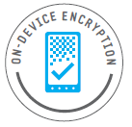

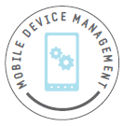
Traditional SAFE Components
Corporate Email /
Calendar / Contacts
On-Device
Encryption (ODE)
Virtual Private
Network (VPN)
Mobile Device
Management (MDM)
WHY
Quickly and easily access corporate email, meeting details, contact info and other critical information on the go
Store proprietary documents, presentations and other corporate data on your mobile device – while keeping that sensitive data protected
Wirelessly and securely access data from your corporate network while traveling or working in the field
Employees remain mobile, secure and compliant with remote management of applications and device features that meet company-specific requirements
HOW
SAFE provide an intuitive and consistent user interface through enhanced Microsoft Exchange ActiveSync (EAS) features, sync functions and policy control
State of the art, AES 256-bit ODE helps prevent unauthorized access to all data on the device, including the microSD® storage card
Samsung works with a number of leading VPN providers enabling IP-based encryption for secure, persistent access to critical enterprise assets via Wi-Fi® and cellular network connections
Working with leading third-party providers, Samsung offers efficient and scalable mobile deployment solutions with 338 or more IT policies, addressing the most challenging management and security concerns

Slide 9






Unprecedented Android IT Compliance
Leading VPN and MDM providers leverage Samsung’s advanced Software Development Kit (SDK) to provide industry-leading Android security and control for IT managers
Microsoft Exchange ActiveSync (EAS) – Up to 80 EAS policies and features
On-Device Encryption (ODE) – AES 256-bit encryption on device and SD card
VPN
Mobile Device Management (MDM)
Extended SSL (and soon IPsec) VPN protocols through leading providers ensures accessibility
338 IT policies (substantially more than the nearest smartphone competitor) and 723 APIs by Samsung – the most comprehensive in the industry
Solid partnerships with leading vendors enables customer flexibility
#Policies
(#APIs)
338
(723)
276
(537)
220
35
(33)
9
Notes:
We’ve enabled partners to provide advanced security through offering an open and robust SDK.

Slide 10
NOW INTRODUCING KNOX

Slide 11

Architecture
Android Stack
Application
Container (Sandbox)
Android Framework
KNOX Android Framework
Android OS
Security-Enhanced Android OS
Linux Kernel
TrustZone-based Integrity
Measurement Architecture(TIMA)
Secure Boot
Customizable Secure Boot
Protects
Hardware
TrustZone
Security Hardening, Control & Manageability

Slide 12



SAFE with KNOX: What is New, Better …
Today
with KNOX
Highly-Desirable Devices
Even More Suited for BYOD
DEVICES
Enhanced Microsoft EAS Policies and Features
Fortified 256-bit AES On-Device Encryption (ODE)
Enterprise-Specific SDK (Software Development Kit)
Advanced VPN
Enhanced MDM
SAFE
Additional APIs
Per App VPN
Containers and More IT Policies
Application Container
Single Sign On (SSO)
ActiveDirectory Based Management
BYOD

Slide 13
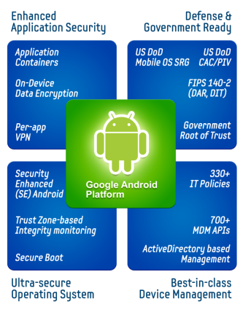
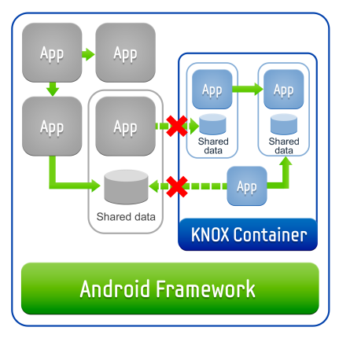
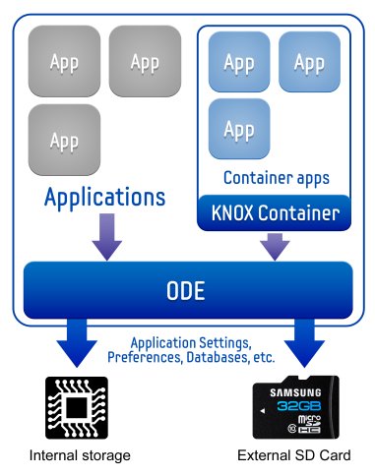
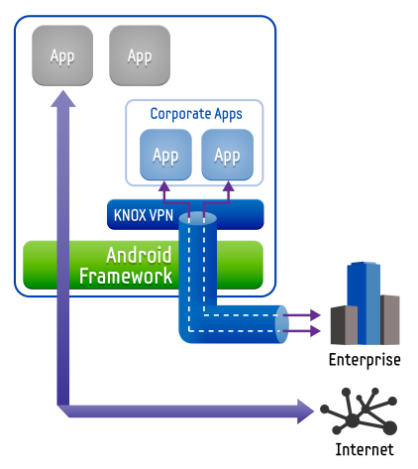
Enhanced Application Security
The containerization capabilities of KNOX represent a key feature that is new to SAFE
KNOX Container
The KNOX Application Container is a virtual Android environment within the mobile device, complete with its own home screen, launcher, applications, and widgets
Enterprise IT administrators can now isolate enterprise applications and data in a secure encrypted environment
On-Device Encryption (ODE)
Allows users and enterprise IT administrators to encrypt ALL data on the device and SD card
All data in the KNOX Container is encrypted by default
KNOX uses a 256-bit AES cipher algorithm to encrypt data satisfying the FIPS 140-2 Data-At-Rest requirements
Enhanced VPN Capabilities
Per-app VPN: IT admins can force all data traffic for an individual application through a VPN connection
FIPS 140-2 certified with NSA Suite B Algorithms, RSA Token and CAC (Common Access Card) support
Existing Best-In-Class SSL and IPsec based VPN support
13

Slide 14
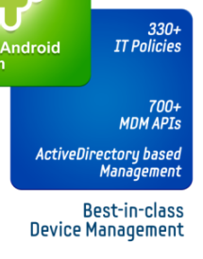
Mobile Device Management
KNOX enhances SAFE MDM capabilities …
Support for the KNOX container – Setup and management of the container is handled by the MDM provider
Support for management via ActiveDirectory – Group Policy Plug-in from Centrify will be available to manage the device
VPN and Wi-Fi Provisioning
Policies to comply with the US DoD Mobile OS Security Requirements Guide (MOS SRG)
NEW
14

Slide 15

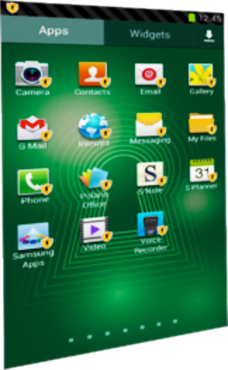
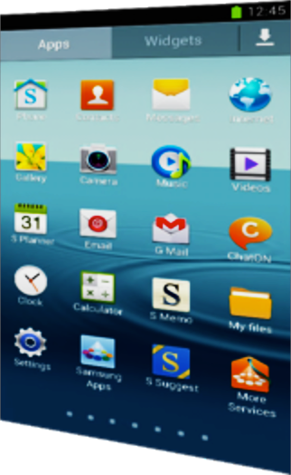









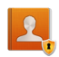



Embracing Bring Your Own Device (BYOD)
ONE DEVICE for WORK & PLAY

Slide 16
Application Container
Enterprise
Apps
Personal
Apps
Container (Sandbox)
Ability to create a sandboxed, company-specific work space
Easily enable market apps to run within the container
Allows remote IT management of container, apps and data
KNOX Android Framework
Security-Enhanced Android OS
TrustZone-based Integrity
Measurement Architecture(TIMA)
Customizable Secure Boot

Slide 17





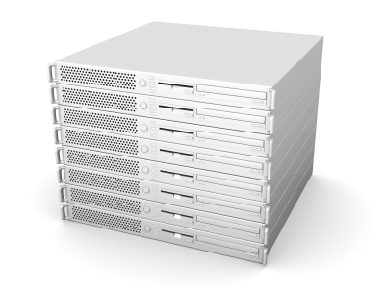
Additional KNOX Capabilities: Single Sign On (SSO)
SSO capability within the container further enhances user experience while remaining secure
The KNOX platform offers Single Sign On support for apps within the container
The user signs into multiple apps at once using ActiveDirectory login credentials
The KNOX SDK offers easy-to-use APIs for applications to implement SSO capabilities
The KNOX SSO solution consists of three components:
SSO client within the KNOX container
A multi-tenanted cloud-based SSO server
A proxy that plugs into the Enterprise’s ActiveDirectory infrastructure
Intranet
Container
…
Internet
ActiveDirectory +
Centrify Cloud Proxy
SSO
KNOX Android Framework
Centrify SSO
(SaaS)

Slide 18
SAFE with KNOX: What is New, Better …
Today
with KNOX
Highly-Desirable Devices
Even More Suited for BYOD
DEVICES
Enhanced Microsoft EAS Policies and Features
Fortified 256-bit AES On-Device Encryption (ODE)
Enterprise-Specific SDK (Software Development Kit)
Advanced VPN
Enhanced MDM
SAFE
Additional APIs
Per App VPN
Containers and More IT Policies
Application Containers
Single Sign On (SSO)
ActiveDirectory Based Management
BYOD
Security Enhanced (SE) Android
Secure Boot
TrustZone-Based Integrity Monitoring Architecture (TIMA)
Govt Ready (FIPS, DoD SRG, CAC/PIV, Custom Boot)
HIGH SECURITY

Slide 19
SE Android
Enterprise
Apps
Personal
Apps
Container (Sandbox)
NSA-developed Technology
Based on Mandatory Access Controls (MAC)
Isolate apps and data in different domains
KNOX Android Framework
Security-Enhanced Android OS
TrustZone-based Integrity
Measurement Architecture(TIMA)
Customizable Secure Boot

Slide 20
Customized Secure Boot
Enterprise
Apps
Personal
Apps
Container (Sandbox)
Prevents “unauthorized” OS and Software from loading.
Allow third-party trusted key management e.g., Government-asserted root of trust
KNOX Android Framework
Security-Enhanced Android OS
TrustZone-based Integrity
Measurement Architecture(TIMA)
Customizable Secure Boot

Slide 21
TrustZone-based Integrity Measurement Arch.
Enterprise
Apps
Personal
Apps
Container (Sandbox)
Protect the integrity of Kernel during run time
Monitor, assert and verify the integrity of the kernel
Run in the protection of TrustZone
KNOX Android Framework
Security-Enhanced Android OS
TrustZone-based Integrity
Measurement Architecture(TIMA)
Customizable Secure Boot

Slide 22



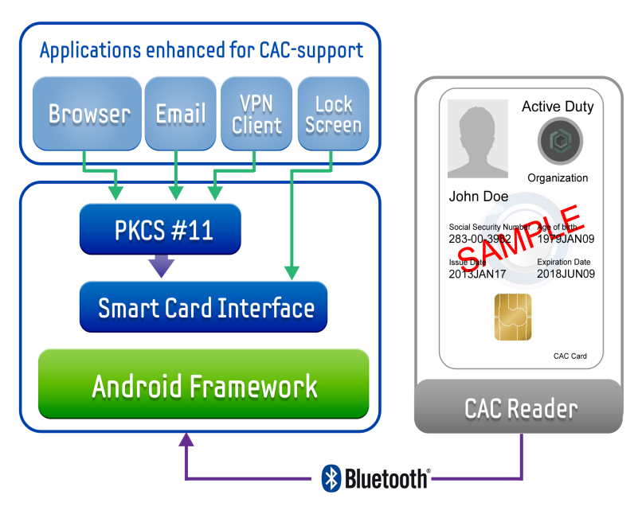

Government and High-Security Readiness
For government and military use, KNOX provides additional security features
SRG Compliant
Government-attested Secure Boot
KNOX devices will be manufactured with a US Gov’t certified root-of-trust
When the device boots up only a US Gov’t approved OS will load
CAC (Common Access Card) Support
DoD approved secure device access
Secure PKI Certificate Based
Authentication for
Device Lock Screen
Browser
Email
VPN Client
Certifications and Compliance
Meets requirements for FIPS 140-2
Level 1 certification for both data
at rest and data in transit
MDM policies to comply with the
U.S. DoD Mobile OS Security Requirements Guide
22

Slide 23


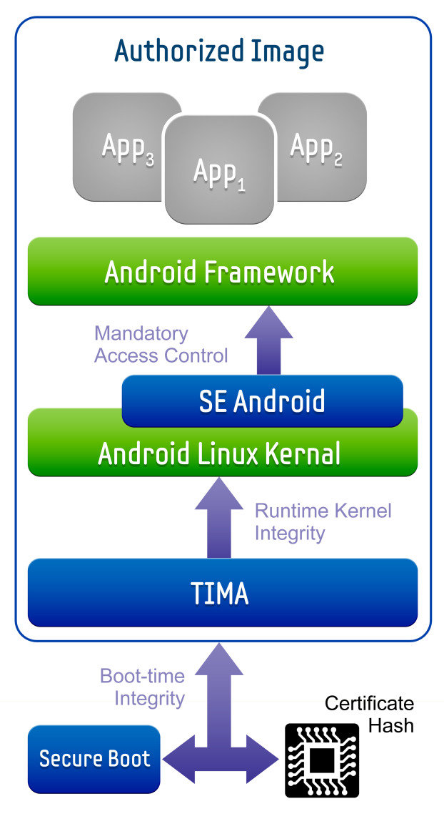
Operating System Security
KNOX leverages 3 core components to ensure device integrity down to the hardware layer with strong native protection against malware
Secure Boot prevents unauthorized operating systems and software from loading during the startup (boot) process
The TrustZone-based Integrity Monitoring Architecture (TIMA) acts as a watchdog over the lowest levels of the Android OS
Security-Enhanced Android (SE Android), originally developed by the NSA, offers a new highly secure architecture for Android
1
3
2
2
3
1
23

Slide 24



Summary
Enhanced
Application Security
Defense &
Government Ready
Dual Persona (container)
Security Enhanced Android (Based on US NSA developed technology)
Hardware-supported Operating System Security
Integrity Monitoring
Customizable Secure Boot
Enterprise policy enforcement:
390+ IT policies
840+ MDM APIs
Application Containers
US DoD
Mobile OS SRG*
(*in process)
CAC/PIV
On-Device Data Encryption
FIPS 140-2
VPN
Per-app VPN
Government
Root of Trust
Security Enhanced (SE) Android
390+
IT Policies
840+ MDM APIs
Trust Zone-based
Integrity monitoring
Active Directory based
Management
Secure Boot
Ultra-secure
Operating System
Best-in-class
Device Management

Slide 25


The Next Big Thing for Business is Here
With highly-desirable devices, Samsung has assumed the #1 smartphone and Android position and continues to grow in both categories
Samsung addresses BYOD trend and IT concerns by making it safer than ever to do business on Android with SAFE and now KNOX
Samsung is committed to being the #1 smartphone and tablet provider in B2B and will continue to improve and enhance its suite of business solutions
Notes:
Recap the key points.

Slide 26
Q&A
DHough@sta.samsung.com

